Slide 1
YARP
Yet Another Robot Platform

Slide 2
Summary
What is YARP?
YARP Ports
YARP Devices
YARP Tools
Other YARP features

Slide 3
What is YARP?

Slide 4
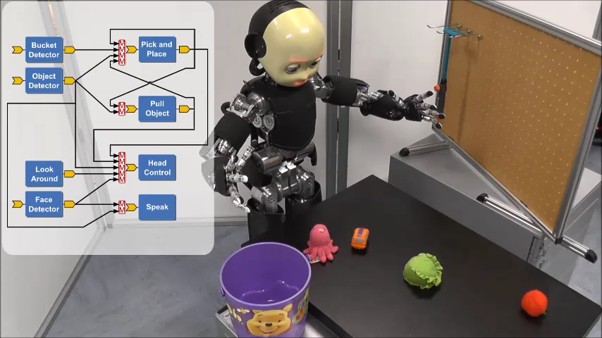
Let’s start from the end – Why?

Slide 5
Why do we need a framework?
Various scenarios and platforms
Hardware changes in time
Lots of different sensors
Lack of standards
Distributed processing
Real-time friendly
Algorithms/libraries/code changes in time
Inherent complexity
Distributed development
Short life span of projects
HARDWARE
SOFTWARE
MAINTAINCE

Slide 6
What is YARP?
YARP is a middleware aimed to ease the development of high level application for robots with a strong focus on modularity, code re-usage, flexibility and hw/sw abstraction.
Homogeneous set of libraries, GUIs, tools,
debug and run facilities

Slide 7
What is YARP?
YARP is a middleware aimed to ease the development of high level application for robots with a strong focus on modularity, code re-usage, flexibility and hw/sw abstraction.
YARP has been designed to support building robot control systems as collection of executables communicating in a peer-to-peer way, with an extensible types of connections (tcp, udp, multicast, local, MPI, mjpeg, XML/RPC, tcpros, ...).
YARP has been historically a C++ library targeting C++ users, but it has also bindings for high-level languages such as Python.
The strategic goal of this kind of design is to increase the longevity of robot software projects.

Slide 8



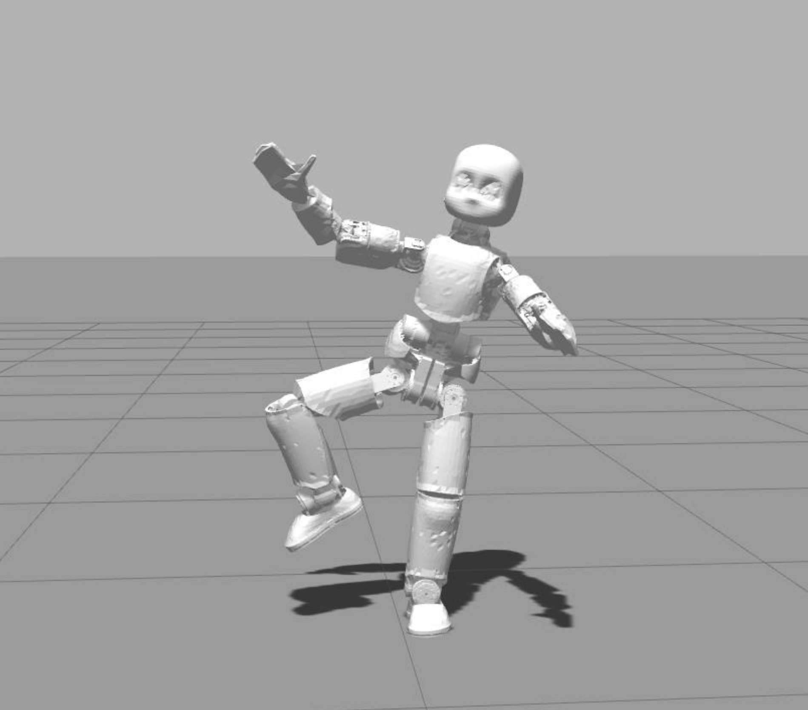

Typical application
Real robot
Simulator
: Process
: Machine

Slide 9

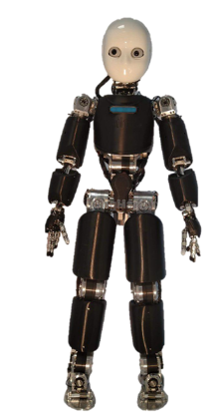
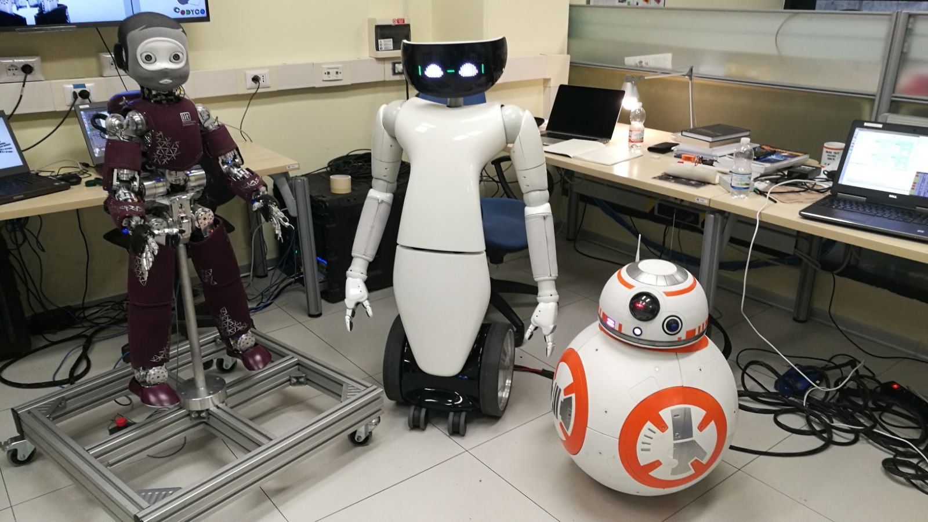
Who uses YARP

Slide 10
YARP Ports

Slide 11


YARP Ports: How YARP communicates
YARP ports are the communication entry point.
A port is a bi-directional communication entity.
Many clients can connect to a port.
Each connection can use different protocols or custom carrier to manipulate data on the fly.
YARP module
udp
Port
Vision
algoritmhs
Port
Robot
mjpeg
Port
Image
viewer
Port
Port
tcp
udp
Port
Control
module
Port

Slide 12
YARP Ports: How YARP communicates
YARP server acts as a DNS, resolving yarp port names into system sockets
tcp
YARP module
Camera
/rpc
/command
vision
algorithms
/image:o
/vision:i
$ yarp name list
/image:o 192.168.1.1:10001
/vision:i 192.168.1.2:10002
/view:i 192.168.1.3:10003
/command 192.168.1.2:10004
/rpc 192.168.1.3:10005
udp
mjpeg
yarp server
image
viewer
/view:i
yarp connect <source> <receiver> <carrier>(tcp)
$ yarp connect /command /rpc
$ yarp connect /image:o /vision:i udp
$ yarp connect /image:o /view:i mjpeg

Slide 13
Data types
class MyData : public yarp::os::Portable
{
// Portable interface toward YARP
read(…);
write(…);
// Custom user methods for data handling
fill_me();
getData();
// Usually for readability
toString();
}
Data in YARP are Portable classes with read and write capabilities. This kind of classes can travel through the YARP network.

Slide 14
yarp::os::Property
Dictionary type of data
Property prop;
prop.clear();
prop.put(“myInt”, 5);
prop.put(“myString”, “Hello World”);
prop.put(“myPi”, 3.14);
Property &myGroup = prop.addGroup(“group1”);
group1.put(“g1”, 2.5);
group1.put(“g2”, “We have cookies”);
prop.check(“myInt”);
Value myInt = prop.find(“myInt”);
double myPi = prop.find(“myPi”).asFloat64();
Bottle &group = prop.findGroup(“myGroup”)
Works in pair <key, data>, where
Key is a string
Data is a yarp::os::Value
Entry can be grouped together, with a key
Entry and group can be searched by the key

Slide 15
yarp::os::Bottle
Most flexible (but inefficient) type of data.
Bottle bot;
void clear();
bot.addInt32(5);
bot.addString("hello");
Bottle& b1 = addList();
b1.addFloat64(10.2);
Property &prop = bot.addDict();
prop.put(“pib”, “Help me”);
Value &v0 = bot.get(0);
Value &v1 = bot.get(1);
Can hold variable number of Value.
Bottle can be appended or nested one into another.
A Property can be an element of a Bottle
Bottle can be accessed using indexes.
Size is the number of element you can get()

Slide 16
yarp::sig::ImageOf<PixelType>
Container for image type
Template working with many different pixel types
Full documentation here: http://www.yarp.it/classyarp_1_1sig_1_1ImageOf.html
ImageOf<PixelRgb> yarpImage;
yarpImage.resize(300,200);
PixelRgb rgb;
rgb = yarpImage.pixel(10, 20);

Slide 17
yarp::sig::PointCloud<DataType>
Container for point cloud type.
Template working with many different point types.
Moreover, it has been implemented to be compatible with Point Cloud Library (PCL) and with an interoperability between different point types.
Full documentation here: http://www.yarp.it/yarp_pointcloud.html
PointCloud<DataXYZRGBA> yarpPointCloud;
yarpPointCloud.resize(300,200);
DataXYZRGBA point;
point = yarpPointCloud(10, 20);

Slide 18
Working with Ports – Client/Server
Ports are identified by their name.
Constraints:
Names must be unique
Names must start with ‘/’ character
No ‘@’ character allowed
Ideal for client/server pattern
yarp::os::Port myPort;
myPort.open(“/port”);
Bottle b;
port.read(b);
int n = b.get(0).asInt32();
n++;
b.clear();
b.addInt32(n);
myPort.write(b);
myPort.close();

Slide 19
Working with Ports -- Streaming
In case of continuously broadcasted data (e.g. video streaming), a yarp::os::BufferedPort<T> can be used.
Main differences:
Data type is fixed for port lifetime
Memory creation/destruction is handled by the port
Buffering policy can be set (default latest message is kept)
A dedicated thread handles the read/write operations optimizing user thread cycle
BufferedPort<Bottle> port;
port.open("/out");
// Get memory to write into.
Bottle& b = port.prepare();
b.clear();
b.addString(“Hello world”);
port.write();
port.close();

Slide 20
YARP Devices

Slide 21
YARP Devices: Hardware abstraction
YARP devices are dynamically loaded C++ classes, that expose their functionalities
They are used to model functionalities under common interfaces, such as sensors (cameras, IMUs, Force-Torques), low-level joint motor control, even if the under the hood the implementation is different
When you launch a robot like iCub, you launch a program yarprobotinterface that creates and run several YARP devices to communicate with the low-level aspects of the robot.

Slide 22
YARP Devices: Hardware abstraction
Client & Server on the same machine
R1
motor controller
YARP ports
Interface
Server Network Wrapper
Client Network
Wrapper
Interface
user application
iCub
motor controller
Simulator
motor controller

Slide 23
YARP Devices: Hardware abstraction
Client & Server on the same machine
R1
motor controller
Interface
user application
iCub
motor controller
Simulator
motor controller

Slide 24
Interfaces
A class with pure virtual methods.
Servers provide functionalities by implementing required methods.
Clients use the functionalities by calling provided methods.
IPositionControl::getAxes() = 0;
IPositionControl::positionMove(…) = 0;
IPositionControl::relativeMove(…) = 0;
IPositionControl::checkMotionDone(…) = 0;
IPositionControl::setRefSpeed(…) = 0;
IPositionControl::setRefAcceleration(…) = 0;
IPositionControl::getRefSpeed(…) = 0;
IPositionControl::getRefAcceleration(…) = 0;
IPositionControl::getTargetPosition(…) = 0;
IPositionControl::stop(…) = 0;

Slide 25
Opening a device
Devices are opened by mean of a special class called “PolyDriver”.
PolyDriver is a polymorphic class which can turn into any device.
Keyword “device” tell YARP which device we really want to open.
All other parameters will be propagated to the specified device.
PolyDriver mystica;
Property config;
config.put(“device”, “device_type”);
config.put(“deviceParam1”, paramValue1);
config.put(“deviceParam2”, paramValue2);
...
mystica.open(config);

Slide 26
Remote Control Board
Device devoted to provide remote access to the robot motor control is the “remote_controlboard”
Required parameter to configure it are:
- Remote port prefix: remote
- Local port name: local
PolyDriver poly;
Property config;
config.put(“device”, “remote_controlboard”);
config.put(“remote”, “/icub/head”);
config.put(“local”, “/<myApplication>”);
...
poly.open(config);
CONTINUE

Slide 27
Remote Control Board
Once opened, we need to specify which interface we want to work with.
To get a specific view of the device:
create a pointer to the interface we want to use
fill it by calling the .view(…) function
In case the device does not implement that interface, the pointer will be nullptr!
A device can implement more than one interface.
IPositionControl *posControl = nullptr;
poly.view(posControl);
if(!posControl) // handle error
...
posControl->getAxes(…);
posControl->positionMove(…);
IVelocityControl *velControl = nullptr;
poly.view(velControl);
velControl->velocityMove(…);

Slide 28
IPositionControl
Give access to main position control commands.
Used to send high level targets, with a velocity & acceleration profile.
For getters, memory must be allocated by user.
Units in YARP are SI compliant, except angles for controlboard, which are in degrees, degrees/s

Slide 29
IPositionControl
int joints;
posControl->getAxes(&joints); // Get number of joints
posControl->setRefSpeed(0, 5); // set a speed of 5 degrees/s for joint 0
posControl->positionMove(0, 30); // move the joint 0 to +30 degrees
bool done = false;
do
{
checkMotionDone(&done); // this function checks the movement completion
}
while(!done);
posControl->positionMove(0, 0); // reset joint position to 0

Slide 30
YARP Command Line and GUI tools

Slide 31
YARP Command Line tools
yarpserver: Launch the name server used to register YARP port names
yarp: command-line utility "yarp" performs a set of useful operations for a YARP network.
yarp name list: list all known YARP ports.
yarp connect <src> <dst>: Connect the two specified YARP ports.
yarp detect: Searches for an activate yarpserver in the network.
See https://www.yarp.it/latest/yarp.html for all the available functionalities of yarp command
yarprobotinterface: Launch a group of devices as a single process, tipically used when you launch a robot
yarpdatadumper: Dump the data connected to a port on a file.
See https://www.yarp.it/latest/#yarp_command_line_tools for a the complete list of tools

Slide 32
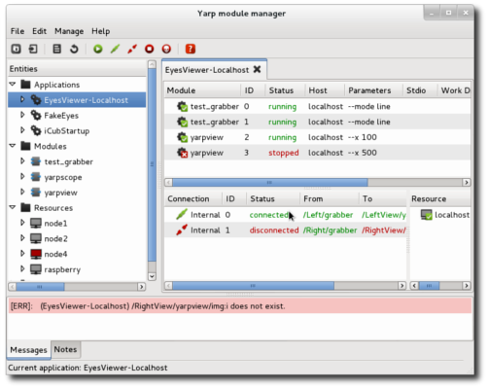
YARP GUI: YARP manager
yarpmanager is a tool for running and managing multiple programs on a set of machines.
The programs/executables that can be launched are called “modules” and are grouped in “applications”, that are specified by XML files.
Specific demonstration on the iCub are launched via appropriate yarpmanager applications
The programs launched by yarpmanager do not need to use YARP to be used via yarpamanager, you can launch YARP independent programs, Bash scripts or Python commands.
https://www.yarp.it/latest/yarpmanager.html

Slide 33
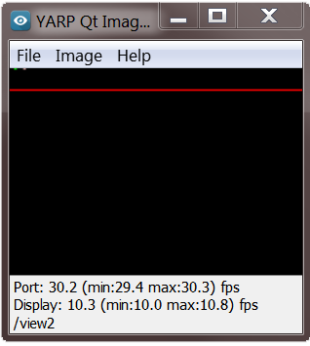
YARP GUI: YARP view
yarpview is a graphical interface for viewing images transmitted on the YARP network.
A typical use of yarpview is to spawn two of them via yarpmanager to visualize the two eyes cameras of iCub.
http://www.yarp.it/latest/yarpview.html

Slide 34
Other YARP features
ResourceFinder
Infrastructure that specifies where configuration and data files are installed and searched, to permit to easily have different configuration files for different experiments or robots.
http://www.yarp.it/git-master/yarp_resource_finder_tutorials.html
https://github.com/vvv-school/tutorial_RFModule-simple
Carriers:
Communicate across ports via mjpeg, h264, unix socket, portmonitor, shared memory, ROS
Bindings:
Support via SWIG for Python, Lua, Ruby, C#, MATLAB/Octave.
http://www.yarp.it/latest/yarp_swig.html

Slide 35
Other middleware
Cool!
“But what about ROS?”

Slide 36


Ports can be typed or not
Multi-platform (also mobile)
Run-time reconfiguration of connections
Different carriers, user custom
QoS, channel prioritization
Smaller community
Rich set of libraries and tools
Binary packages for all supported distributions
Both topic and service are strongly typed
Mainly Ubuntu (ROS2 Linux, macOS and Windows)
Connections from a topic use the same protocol
No concept of carrier (DDS on ROS2)
QoS on ROS2
Huge and very active community
Much more rich set of libraries and tools
Distribution-like facilities

Slide 37
YARP - ROS compatibility
YARP ask roscore to establish a new connection
YARP loads a specific carrier to convert data into ROS-like type on the fly
No need to have ROS installed
https://www.yarp.it/latest/yarp_with_ros.html
YARP module
YARP
module
/port
/topic
ROS
node
yarp server
roscore
/topic@/yarpNode

Slide 38
THANKS FOR THE ATTENTION!

